Slide 1
Welcome!
Meeting Them Where They Are:
Leaning Into Community-Driven Programming

Slide 2
Ground Rules and Participation
We want this session to be as interactive as possible.
Share resources, comments and questions in the chat box.
Be sure to post your chat to all participants by selecting All Panelists and Attendees in the dropdown
The session, including the chat, will be recorded and posted on www.txla.org/webinar-archives within 48 hours.

Slide 3
TLA Code of Conduct
The Texas Library Association (TLA) is dedicated to providing a harassment-free environment for everyone engaged with the association at events and on social media channels, regardless of gender, gender identity and expression, sexual orientation, disability, physical appearance, body size, age, ethnicity, military status, race, or religion.
We do not tolerate harassment in any form at any TLA events or activities, or on any TLA social media channels, including those managed by TLA units. We encourage productive and constructive discussion and participation. Be kind to others.
Find the full Code of Conduct statement at: www.txla.org/code-of-conduct

Slide 4
The Power of Community
TLA membership is your key to the power of a collaborative professional network and professional growth engine. Connect with inspiring colleagues, access exclusive resources, and become a library champion for the industry.
Special Membership Offer
Use code TLASUMMER2024 to save 10% off your 2024 membership.
Visit the website for terms and more information: txla.org/membership/why-join/

Slide 5
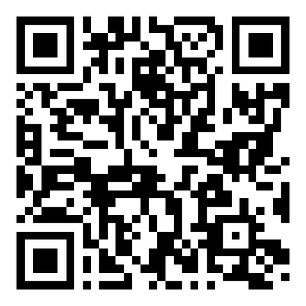
TLA September Webinar
DIY Escape Rooms and Mystery Nights
September 10: 3:00 pm - 4:00 p.m.
Presenters: Amanda Cawthon, Kassandra Gaither
Free for members, $25 for non-members
Register Here:

Slide 6
TLA Self Paced Learning
TLA Self-Paced Learning is a chance for you to earn CE credit from the convenience of your home or office with deep dives into relevant topics for library professionals.
Scan QR code for more information.

Slide 7
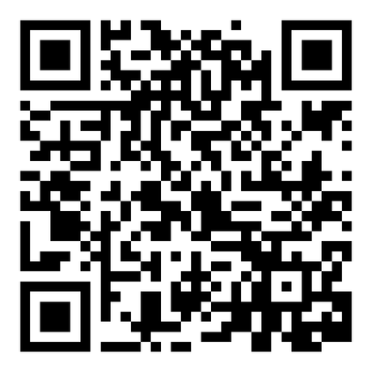
Frontline Fundamentals:
Customer Service Skills
This four-part series aims to equip library workers with essential skills to serve their communities effectively and thrive in their roles.
Registration is open until October 7th.
Scan QR code for more information.

Slide 8
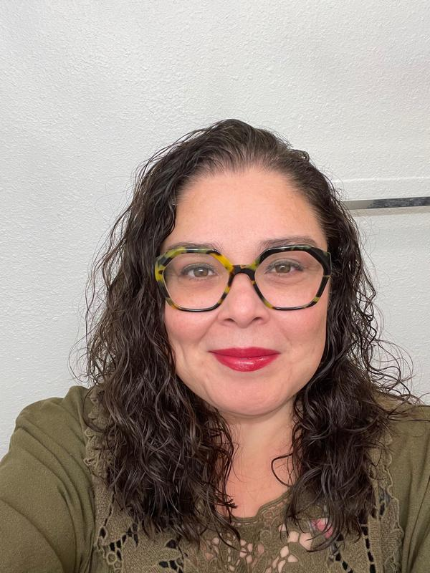
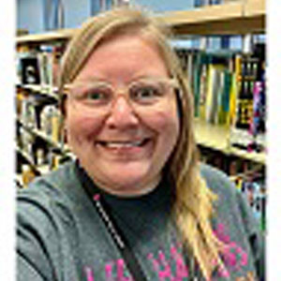
Meeting Them Where They Are
Linda Lopez
Amanda Neace
San Antonio Public Library
San Antonio Public Library

